Slide 1
SIHMON
Smart Infant Health Monitor
Naman Pal Eshan Salwan Satinder Kaur Zoyeba Mahbub

Slide 2
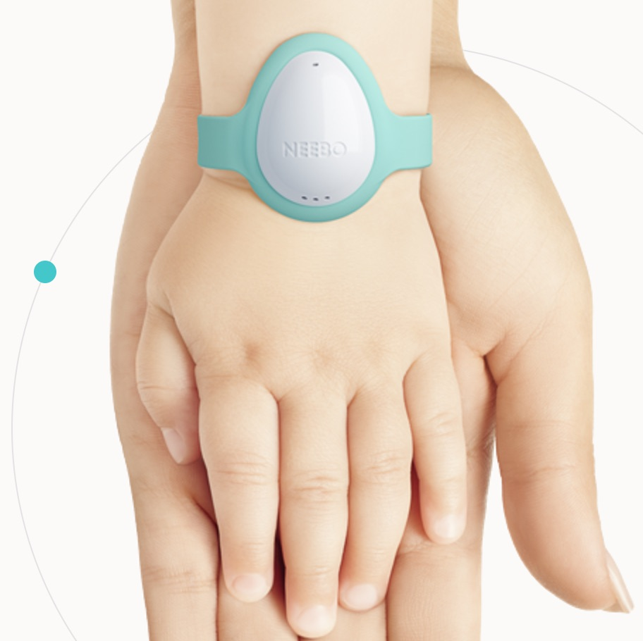
Agenda
Introduction
Hardware Components
Software Development
Integration
Testing
Conclusion

Slide 3
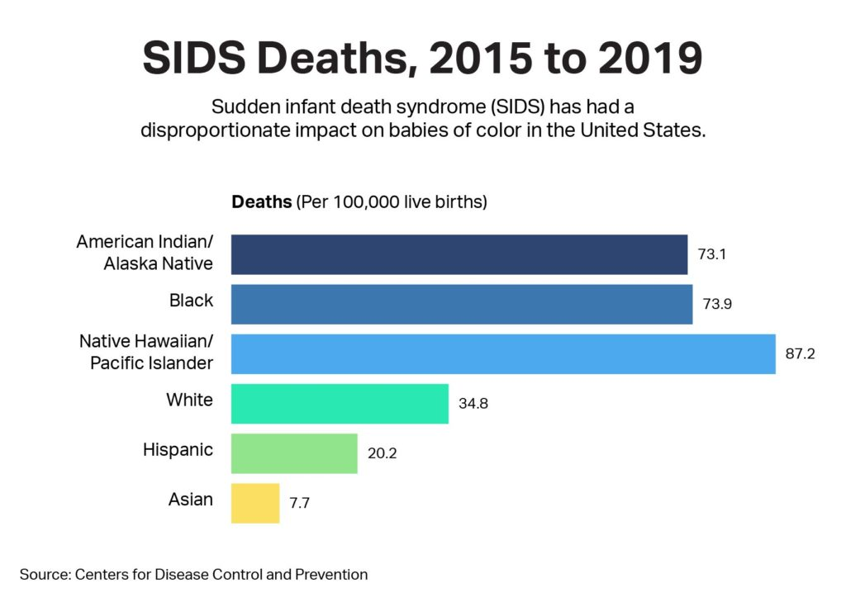
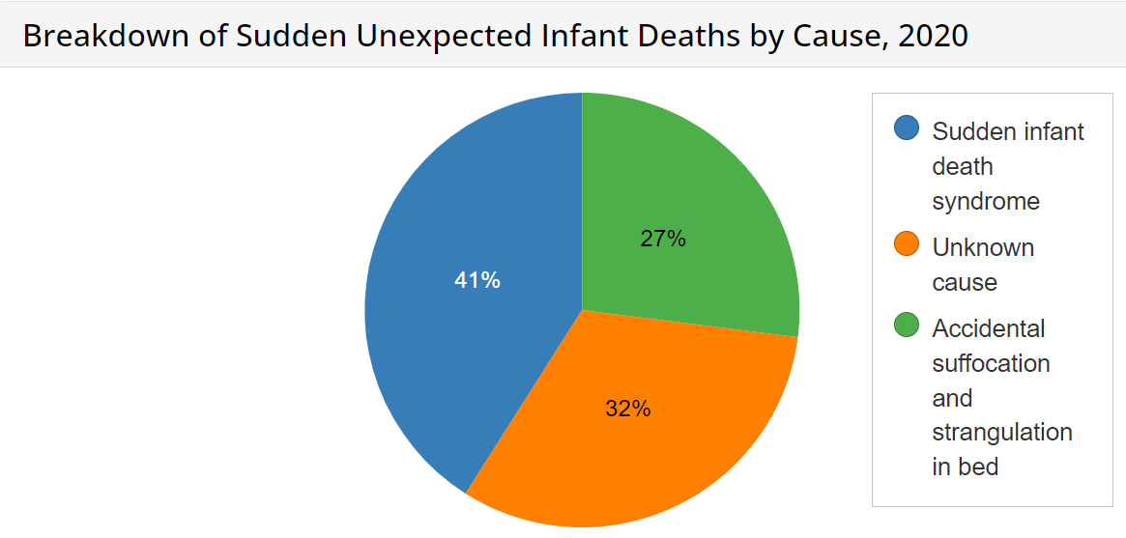
Problem Domain
SIDS causes 2500 infant deaths per year (US).
Gastrointestinal issues: leading cause of deaths of kids 5 and under (US).
Respiratory infections: cause 5/1000 live births (US).
1 million deaths due to parents being unaware of prematurely born babies health (WHO).

Slide 4
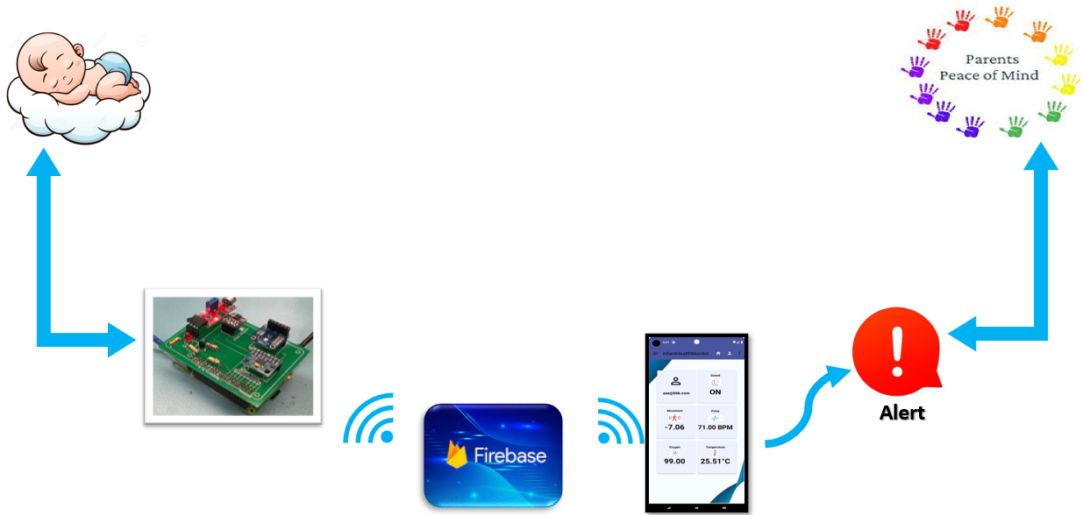
Solution
SMART INFANT HEALTH MONITOR
Advanced Health Monitoring
Real-Time Alerts
Data-Driven Insights: based on data.
Empowering Caregivers.

Slide 5
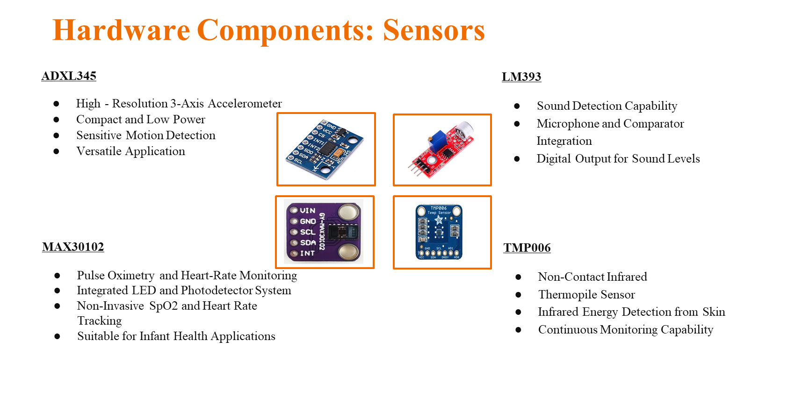

Slide 6
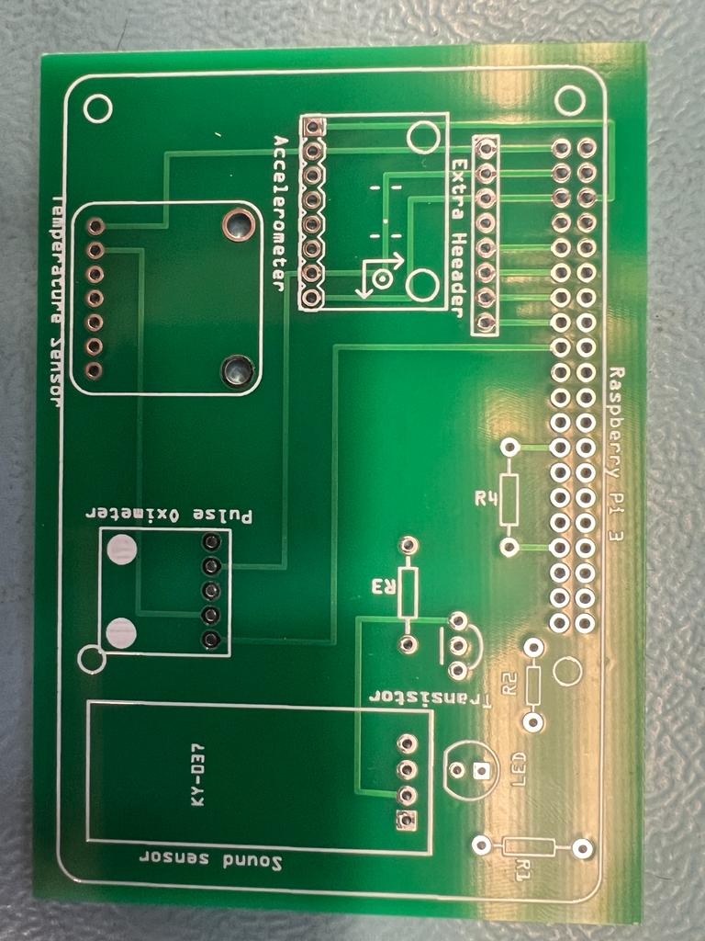
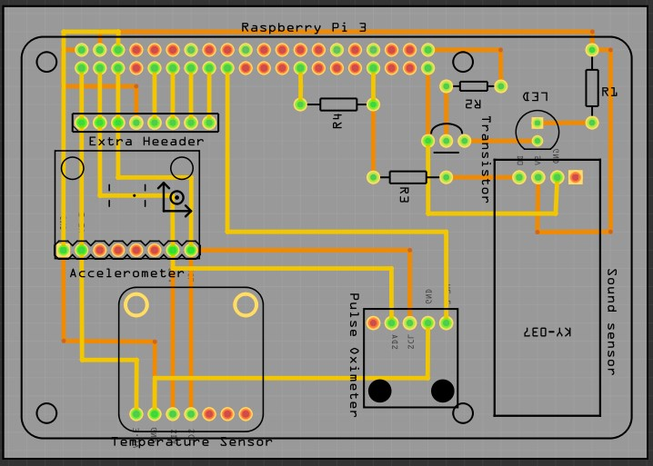
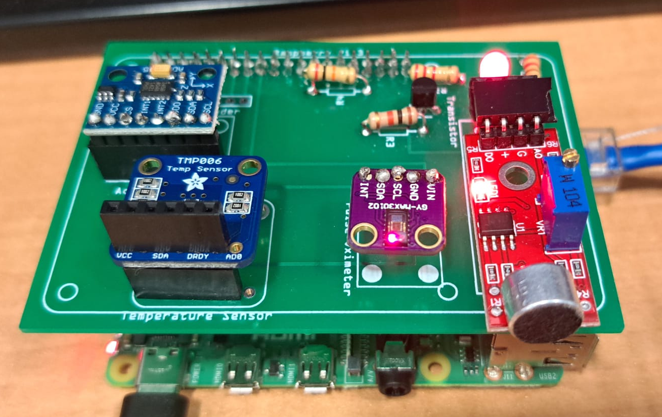
Assembly
Designed PCB layout and circuit schematic using Fritzing
Converted digital design to physical board through manufacturing
Connected soldered components on the PCB, including transistor, resistors, sensors and LEDs to the Raspberry Pi

Slide 7
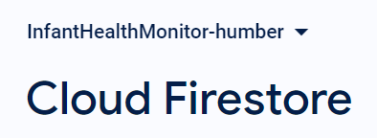
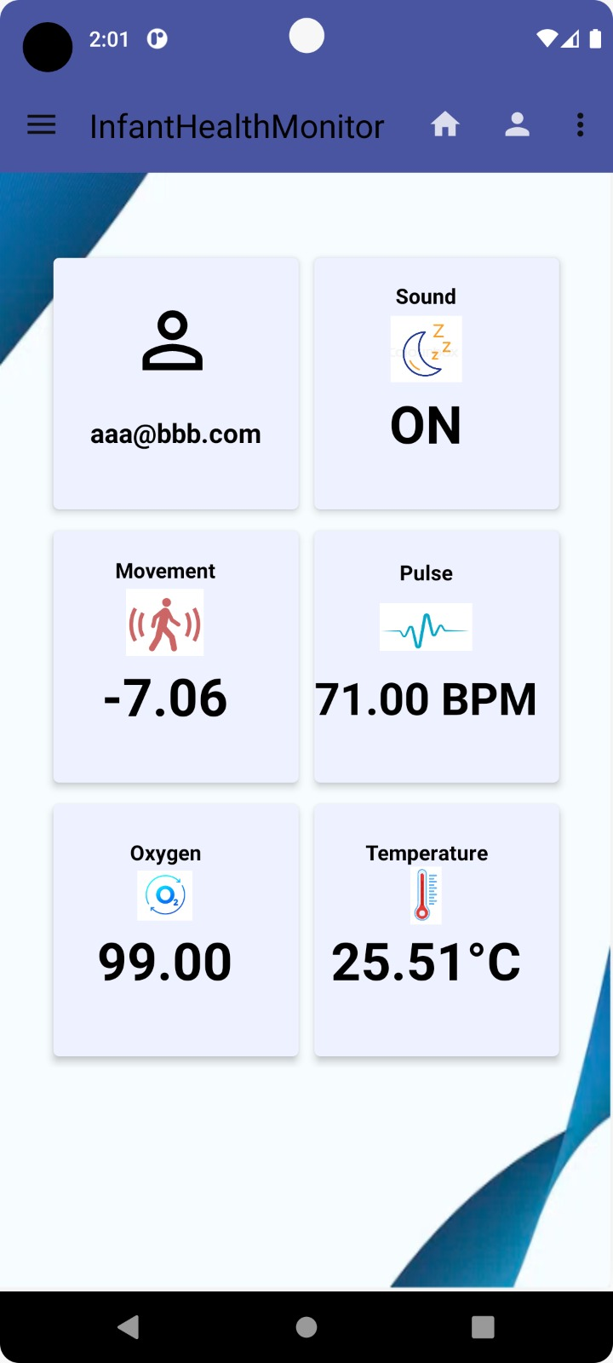
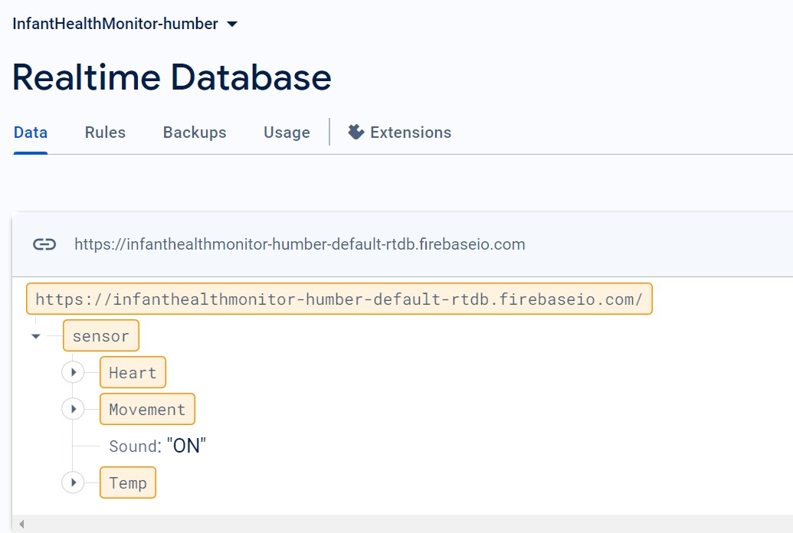
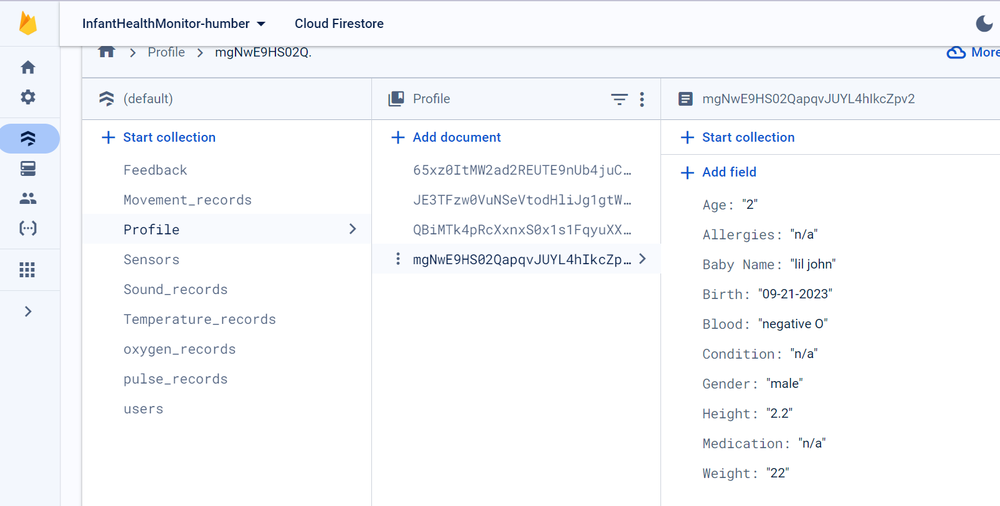
Firebase
Mobile Application with real time readings from the Firebase database
Readings from the sensors to the Realtime database

Slide 8

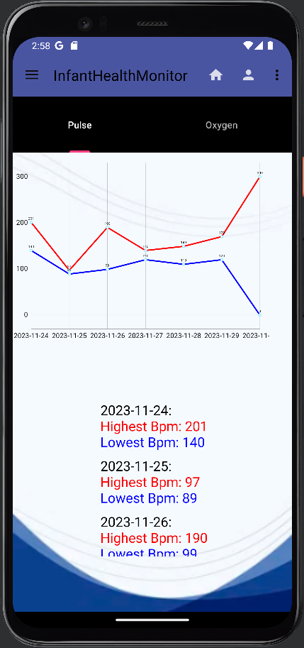
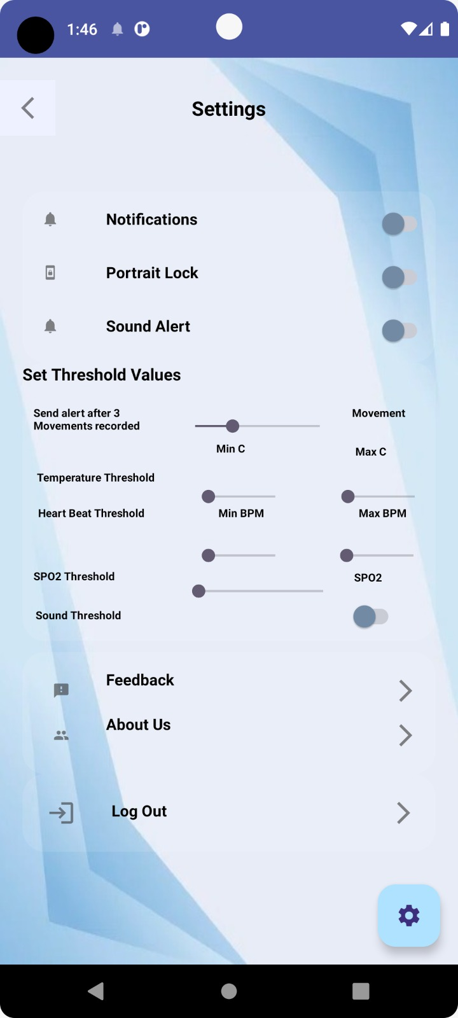
Screens
Login
Screen
HomePage
Screen
Sensor
Screen
Settings
Screen
Tuesday, February 2, 20XX
Sample Footer Text

Slide 9
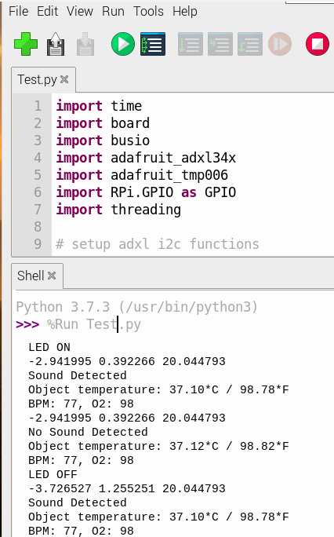
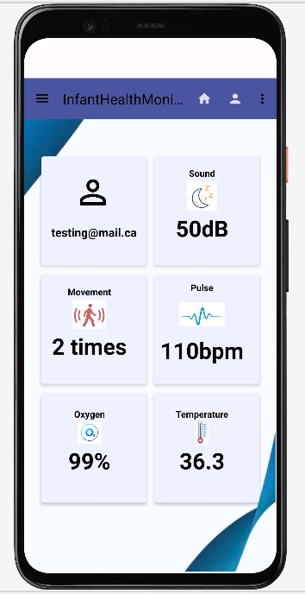
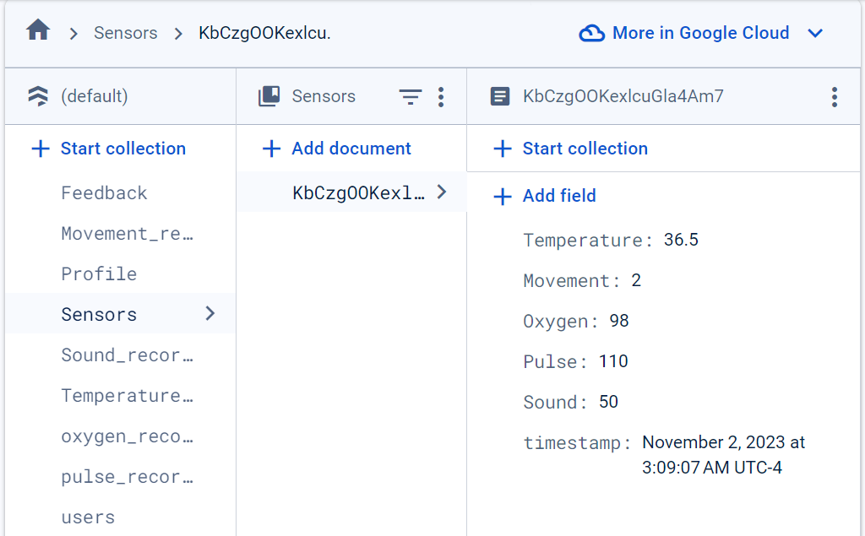
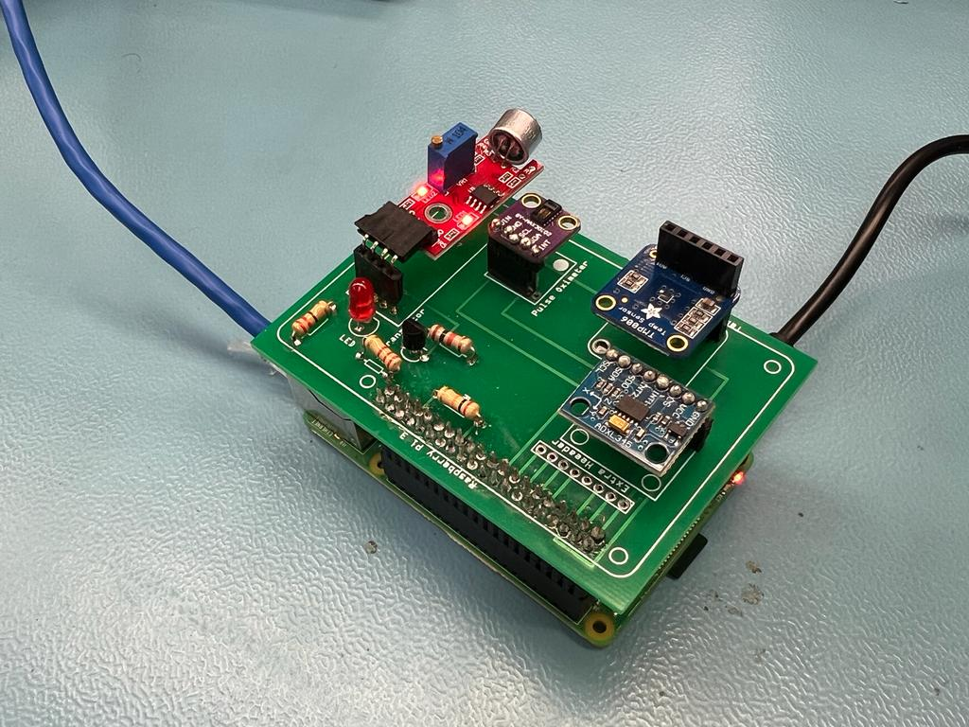
Testing and results
Assembly with Raspberry Pi, PCB, and sensors, data is visible on Firebase.
Data and graphs updated on the app.
App analyzes data and shows insights.

Slide 10

Conclusion
Advancing Infant Care: Safeguarding infant health through advanced, non-invasive monitoring.
Empowering Caregivers: Ability to respond swiftly to the infants' needs.
Commitment to Innovation: Continuous improvement and innovation in healthcare technology.

Slide 11
Thank you !!!
For exploring our vision for a future where every infant is monitored ensuring proper care and a healthier society. Together, we can make this vision a reality.

